Slide 1




1
OneNote Integration through Modern Facial Recognition Techniques
Integrating Facial Recognition with Modern Applications
Presented By : Abhinay Khalatkar
Notes:
I am abhinay ,I am currently in my master thesis semester and I have chosen the topic of “Integrating Facial Recognition with Modern Applications
”

Slide 2








3
Content
1
2
3
4
5
6
7
8
Objective
Requirement Analysis
User Flow
performance Metrix
Techniques Used
Performance Evaluation
Demo
Future Scope
Notes:
This is a general topics which we will be visiting in this Presentation

Slide 3





2
Objective
The primary problem this thesis aims to address is the development of a real-time face identification system that not only recognizes faces but also associates them with specific names. Once a face is identified and named, the system should automatically open a corresponding section in Microsoft's OneNote.
Notes:
In the thesis the objective was to create a robust Realtime face identification application which should give output as users names and then we can integrate it with one note api to fetch or create the notes specific to that user. Basically just a smart app for people who are too lazy to remember the names. But real life scenarios where we can use such application could be lets say wob employe gets into the office we could show a nice greeting message based on that specific employee on the front screen ,in such case it will take advantage of different apps of Microsoft office api rather than just one note. So While some part of the thesis was to develop such application , the major focus was on research and find ways to make existing face identification models more efficient and less computationally taxing , like the ones we have used in the demo app . NEXT UP

Slide 4



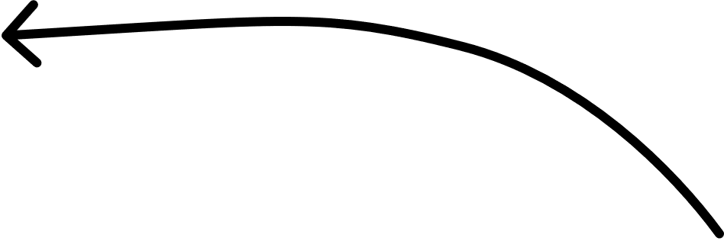
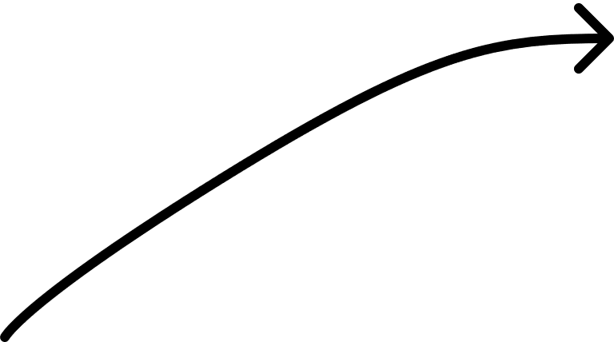
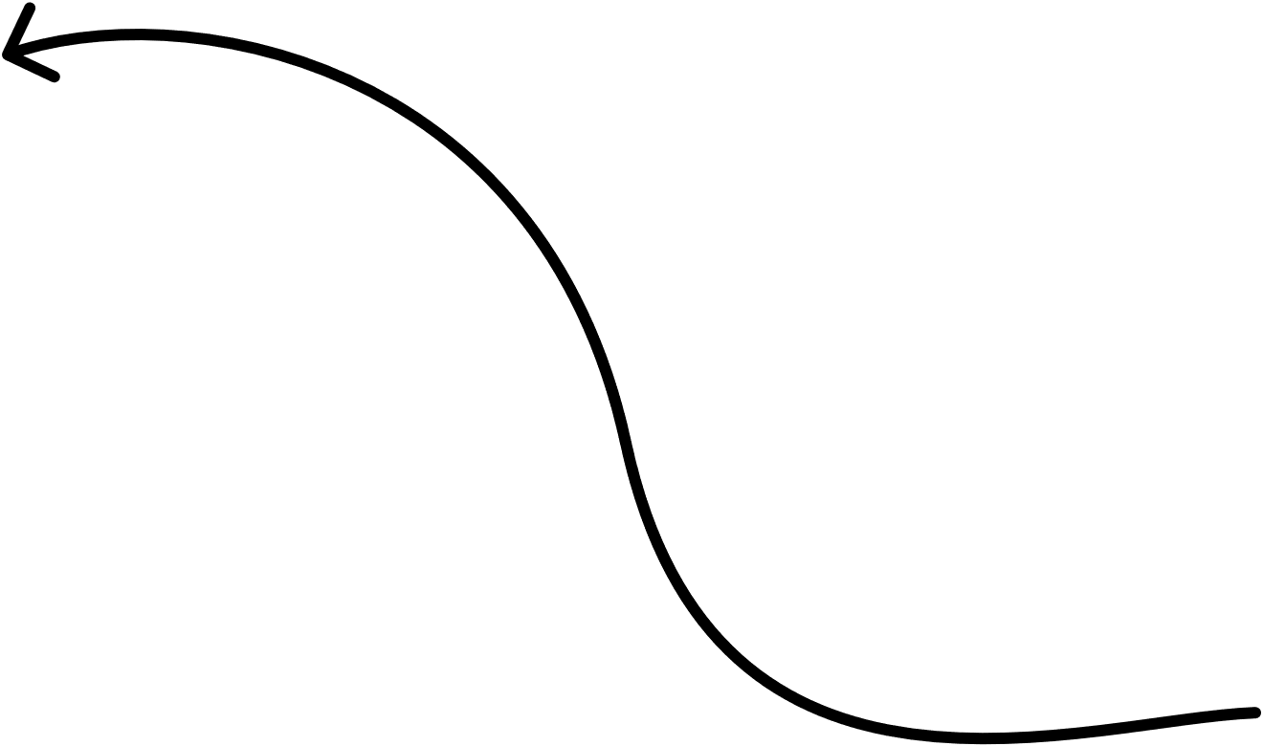

4
Requirement Analysis
Should have realtime and fast performance of face identification .
Face recognition Should be accurate.
Should not be Computationally Taxing.
Privacy concerns - data should be processed locally.
UI should be easy to navigate.
Secure access - one Note data should be accessed securly.
Should handle Data Storage In One note Properly.
Notes:
This is the requirenment analysis which we deduced based on end-users needs- such as of course it should be accurate while also should be fast. Thers were also some privacy concern as such all the face data should be stores and processed locally. Some authentication method to access one note securely, the application it self should not be very power hungry and should run smootly. MOVING FORWERD

Slide 5

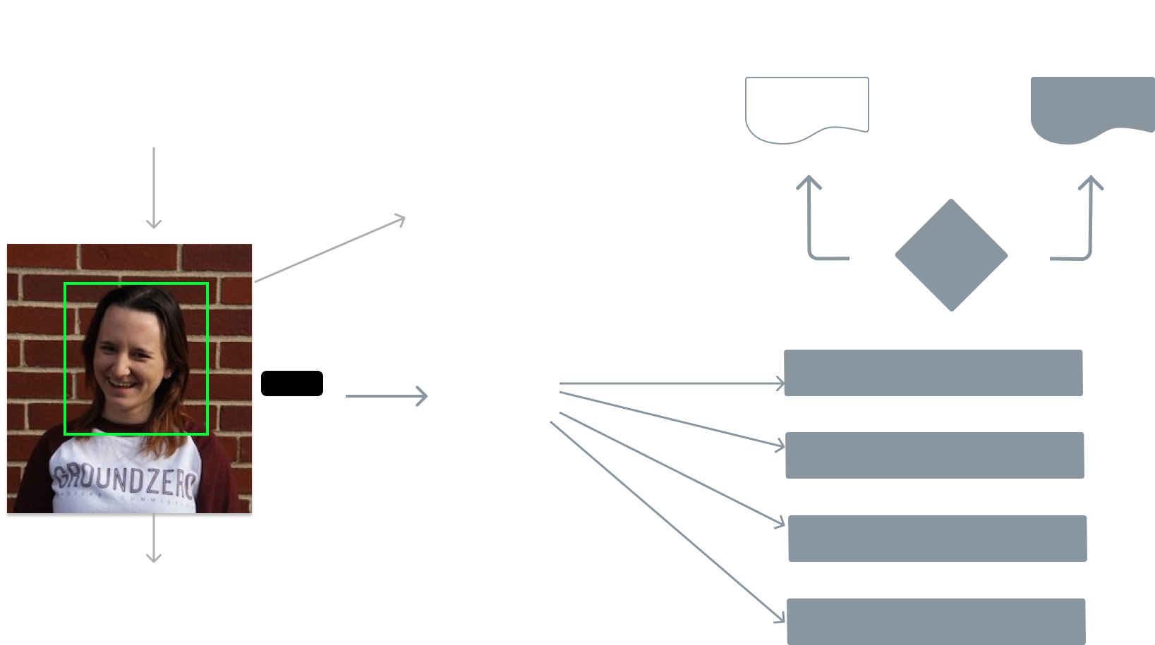

User-Flow
5
authV2 Graph Authentication
Create Section and Open
Open Saved Section
Names=[‘Sara’]
Does Section Exits?
No
Yes
Sara
User Interaction
Open One Note
Add Face
Clear Names
List Identified Names
Embeddings File
Quit
Notes:
This is the user flow of how the app works
We are first authenticating using graph apis AuthV2 authentication methond. which is very secure, and we have to fetch the new token to open the app every one hour once the token is expired.
Later we have the face Identication window were the users faces identification will take place.
Where Everytime a face is identified its name is pushed to Names array.
We can Further interact with app and perform certain operations
After add button is clicked we will be redirected to capture window NEXT

Slide 6







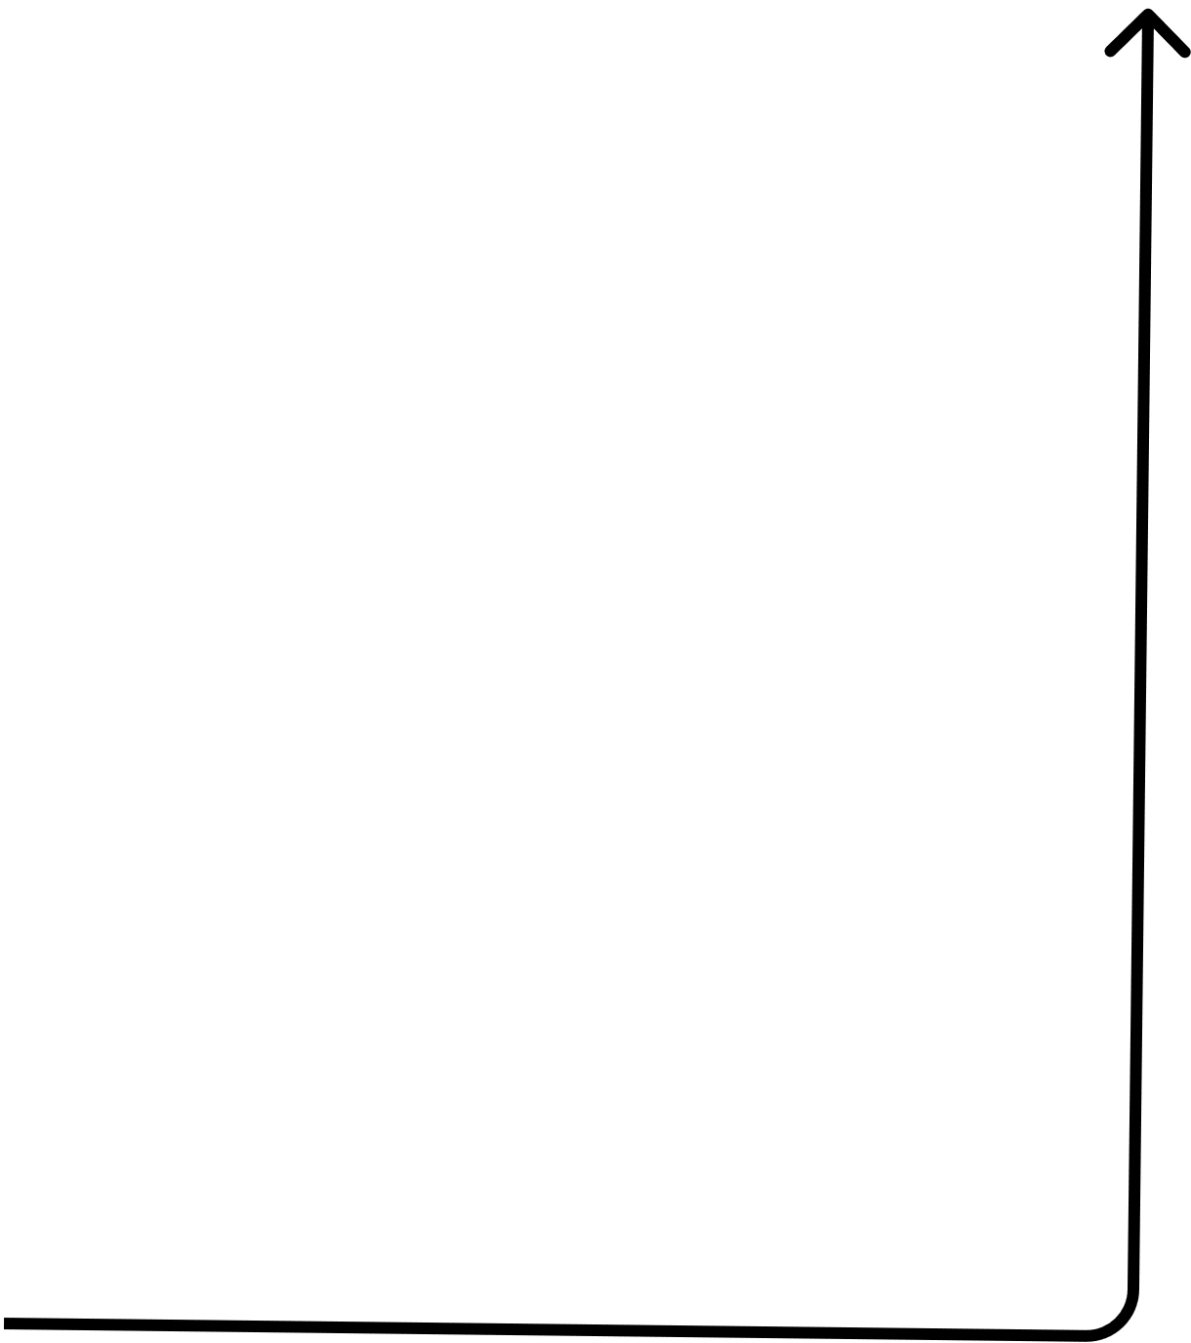
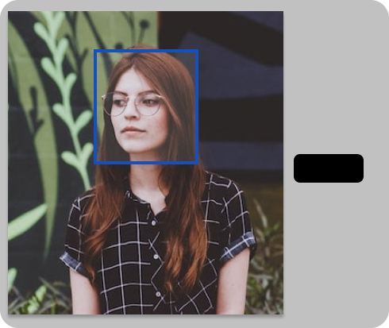
User-Flow
6
Embeddings File
Retrain Model
Input the Name
Capture
Notes:
Over here after clicking on capture button it will start capturing series of images and then store them with given name in database then the application will retrain the model and store it in embeddings file -which could be considered as a listing of all the face features converted in a mathematical format properly stored in different directories based of of name which we gave in the input name tab.

Slide 7


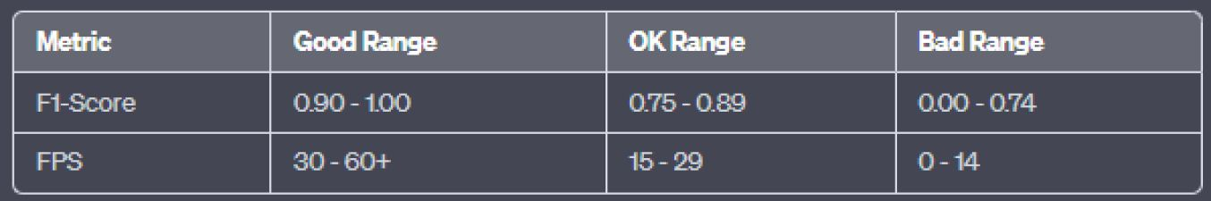

performance Metrix
7
FPS(25-30)-Frames per seconds F-1 Score- balanced average of Precision and Recall Resource Utilization- CPU and GPU usage
Notes:
Now in order to evaluate our application we had to use certain metrix such as F1 score and simple Frames per second counter along with we have also monitores the CPU and GPU usage
The F1-Score is a balanced measure of a model's accuracy that takes both precision and recall into account. It ranges from 0 to 1, where 1 indicates perfect precision and recall.
For a face identification system, accuracy is very important factor. The F1-Score helps us understand how well the model identifies faces (true positives) while minimizing false positives and false negatives.
The F1-Score is the harmonic mean of precision and recall, where
Precision is the ratio of correctly predicted positive observations to the total predicted positives and
Recall can be considered as Sensitivity or True Positive Rate, is the ratio of correctly predicted positive observations to the actual positives.
In simpler words
Precision deals with cases where the model incorrectly labels a negative instance as positive. while
Recall deals with cases where the model incorrectly labels a positive instance as negative.

Slide 8
Techniques Used
9
Histogram of Oriented Gradients (HOG)
Max-Margin Object Detection(MMOD)
Dlib 68-face feature identifier
Notes:
HOG short for Histogram of Oriented Gradients works by defining gradiants, Now Gradiants is just a fancy way of saying Edges . This is the pixel or a small unit of picture where the contrasts shifts drastically compared to previous pixel , such points are labelled as gradiants and are then recored with its vector giving it a director, we then create a list of such vectors in order to identify that specific object . After further processing this vecors are then copared to each frames in a realtime feed giving us a certain confidence threshold as to wether a face is found or not.
Max-Margin Object Detection short for MMOD model is also a object detection model. While begin very accurate boasting a accuracy rate of upto 99.6% it is more computationally taxing so we use it in conjunction with HOG model. Where if Hog cant detect a face in a frame then that frame is passed to MMOD in this way we can get best of both world while having speed along with accuracy.
68-face feature identifier provides us with tha abality to compare the face features. its part of Dlib library which we used for face identification. Moving forwerd

Slide 9

Dynamic Region of Interest
8
Initial Frame: The Starting Point
No Face Detected: Maintaining the Status Quo Single Face Detected: F=((x,y,w,h),S) Add some Buffer to ROI
Multiple Faces Detected: Expanding the Scope Temporal Consistency Check: decreasing false positives Periodic Reset: Catching New Faces
Notes:
To the core and heart of the research part of this thesis is the Dynamic Region of Interest. ROI or region of interest in the field of computer vision is an area of a frame which will be given to the face detection model in order to be processed for identification.
In our application where accuracy was paramount ,speed was also an important factor so that the video feed can be updated in real time. So we came up with the idea of dynamic ROI, here when the precise vectors of a face is found in an image initially we get the coordinates in X,Y format where as W and H being the height and width and S being the confidence score , we get each vectors in such way so we can determine the exact start and end of a detected face now this coordinates are recorded and then given to the next frame as a point of reference to tell it where the next face could be detected ,this way we can significantly reduce the ROI and computational time can also be reduce. We also added some buffer area so that ROI will be a bit bigger than the detected face ensuring proper working . In case of multiple faces the starting vector of first detected face and ending vector of last detected face will be considered. And for the initial frame the ROI will be set to max . Also we have added periodic rest so after certain time interval the ROI for the next sub-sequent frame will be again set to max so that new faces can be accommodated in the live feed. NEXT up we have

Slide 10

Temporal Consistency Check
6
the issue of false positives could not be entirely eliminated This feature maintains a history of the last 5 face detections. The Region of Interest (ROI) is updated only if a face has been consistently detected in at least 4 out of the last 5 frames. The temporal consistency check adds an additional layer of verification to the face detection process
Notes:
This feature mainly affect the F1 score since it deales with reducing false positive detections. Thus making face detection more accurate.

Slide 11

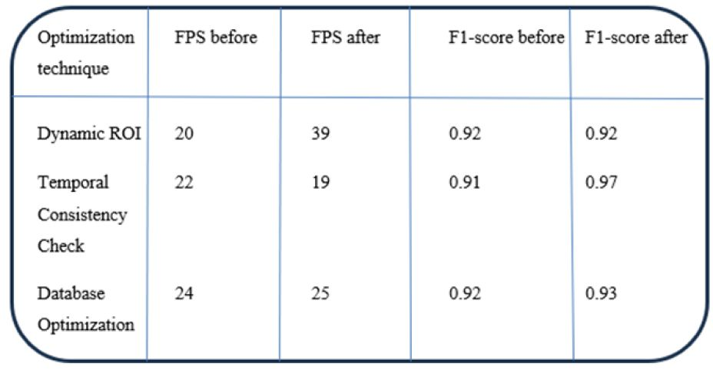
performance Evaluation
7
Dynamic Roi- By reducing the area of interest, the algorithm has fewer pixels to process, thereby increasing the FPS.
Temporal Consistency Check- This technique made the system more resistant to false positives, thereby improving the F1-Score.
Notes:
Now as per the evaluation of different face detection model we tested while researching of fitting one for our application. The result was shown with some very positive results. where as Dynmaic Roi and Temporal consistency check made the most difference, were as we saw a Whopping 95-100% increase in FPS where as temperol consistency increase the F1-score by an average of 0.6-0.7 points. NOW moving on to the DEMO

Slide 12
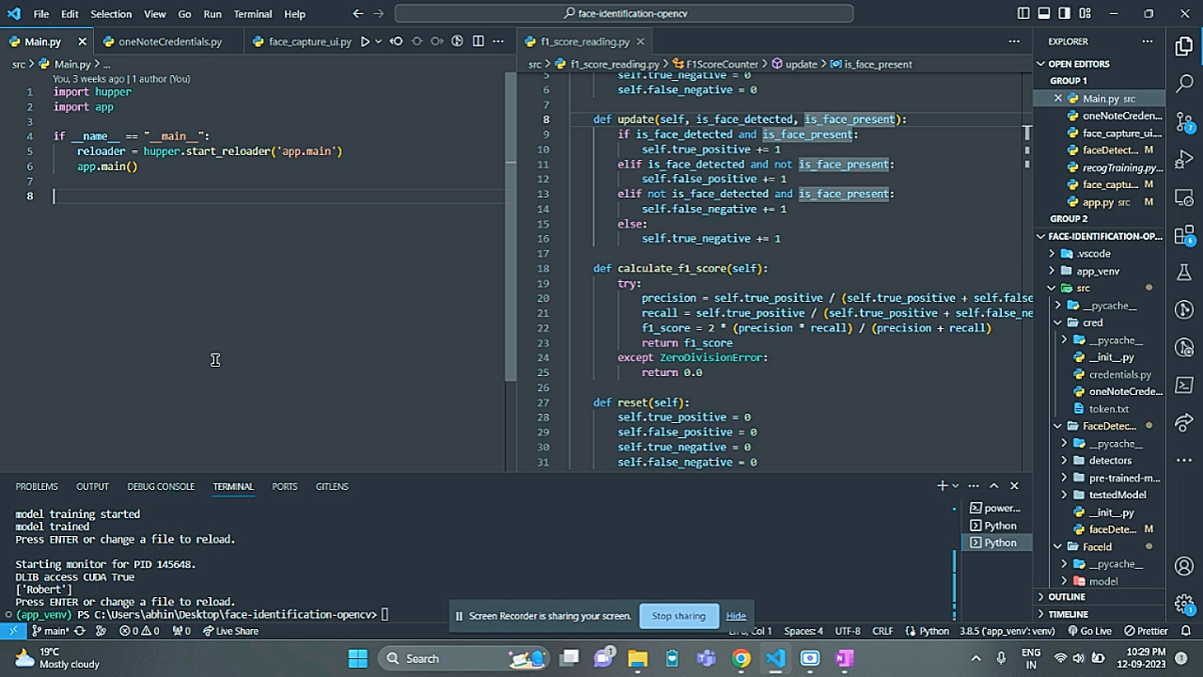
DEMO
9

Slide 13

Future Scope
More Seamless UI
To make use of Different Graph Api possible in single application
To make it more Secure
Notes:
As for the future prospects i would like to make a better UI as the current goal of thesis was more focused on the backend . Next is to have access to more applications API so further interaction can be made between apps such as Microsofts Teams and word or power point. And the most important is to make it more secure as we saw just now in the demo the model was still detecting a face which was basicaly a picture in phone , such things can have further privacy concerns- on that point one of our client trinamix is developing technology such as Beam profile analysis which actually makes sure that what we are scanning is acually a face of a person that too in real time, thus elemeinating concern such as identitiy frauds and saftly of our personal info. usage of such technology can also increase the security of application such as the one we made and other face detection applications also.

Slide 14


18
Thank you!
Notes:
And that was the end of the presentation . If anyone have any feedback or any other questions regarding the presented stuff or any other aspect of it then please do let me know later. It would be beneficial for my thesis , Thank You.

